Slide 1
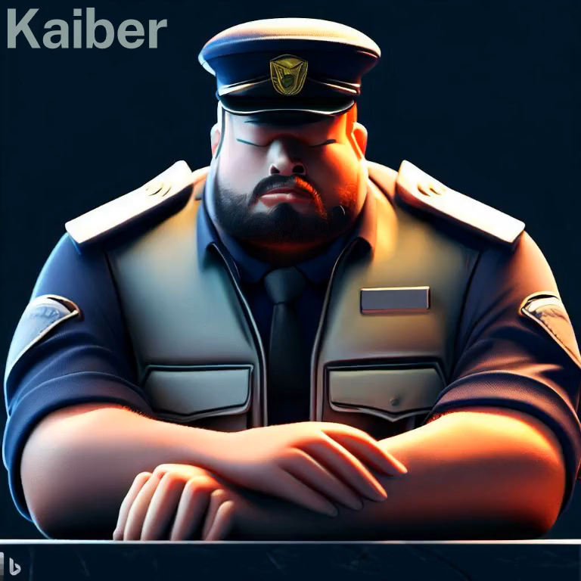

High-Alert
Capstone Project Phase 1
Security Guard Unawareness Detection System
Supervisor: Mrs. Aliza Atally
Students:
Yohan Leykin
Haim Hadad

Slide 2

Agenda
Problem
Solution
Model architecture
Challenges

Slide 3
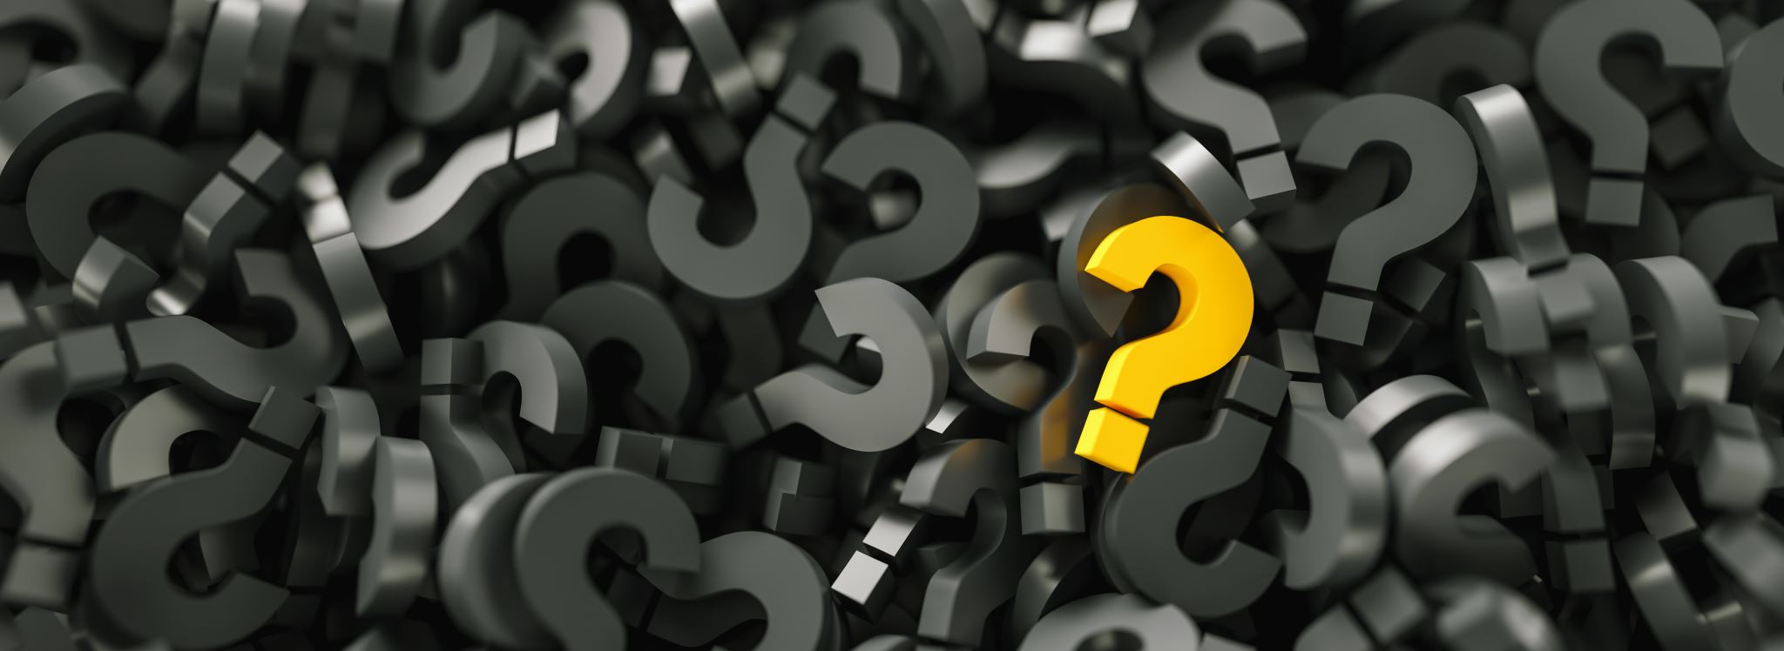
Problem

Slide 4
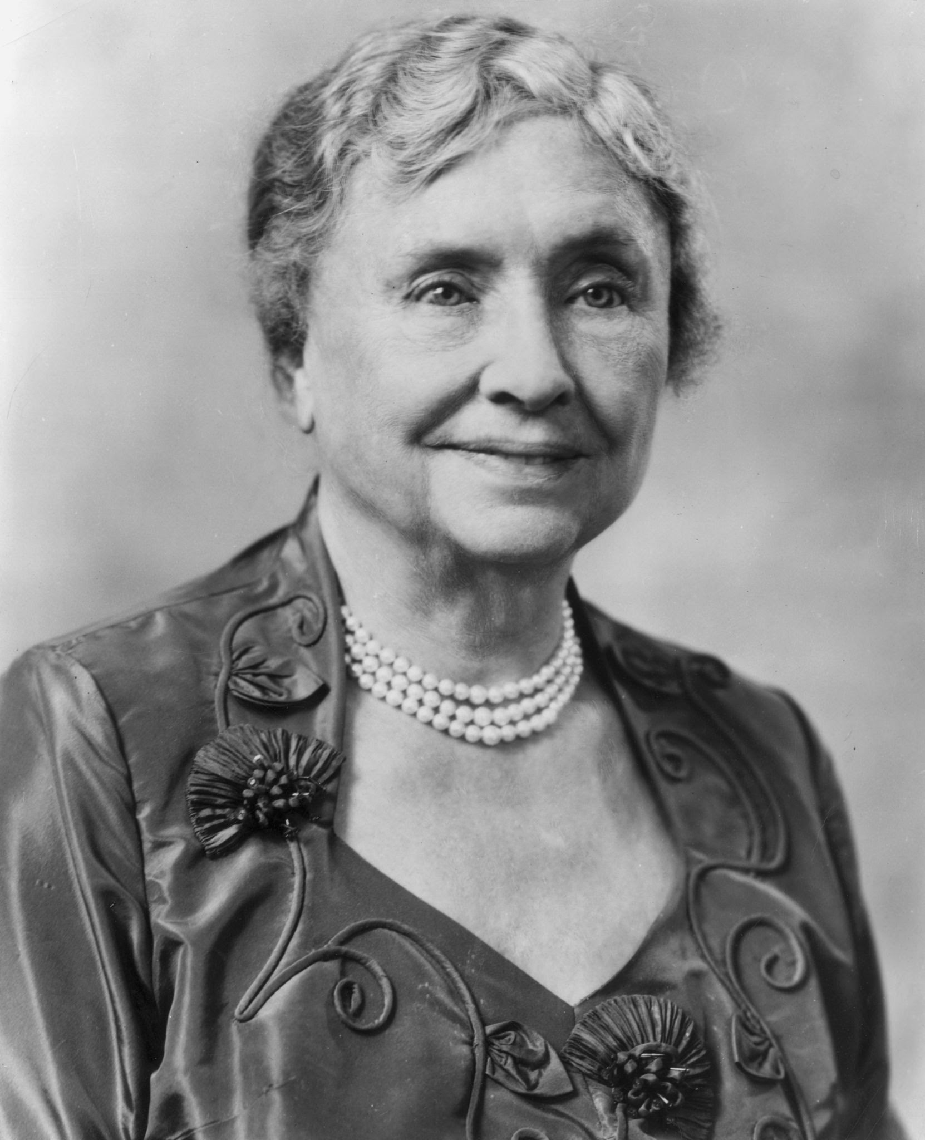
"God himself is not secure, having given man dominion over his work”
Helen Keller

Slide 5
Problem
Security guards are vital for maintaining the safety of public spaces, however, Incidents such as theft, vandalism, and violence can occur when security guards are unaware, leading to loss of property and sometimes injury or loss of life.

Slide 6
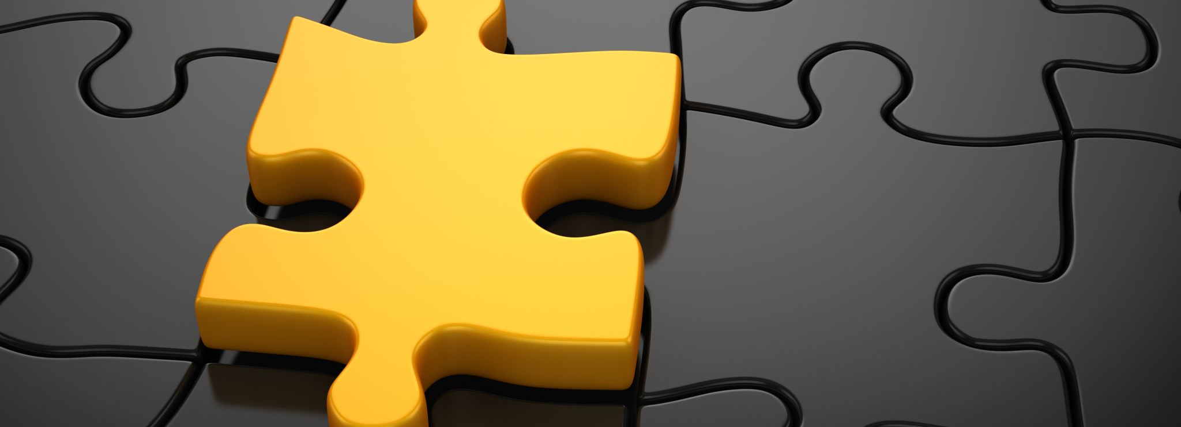
Solution

Slide 7
High-Alert
To address this issue, this academic project proposes an approach that utilizes computer vision techniques to analyze the behavior and facial expressions of security guards and predict their awareness levels.
If unawareness detected the system will notifies.

Slide 8

Existing methods
Physical based
Machine based
Real-Time face detection

Slide 9
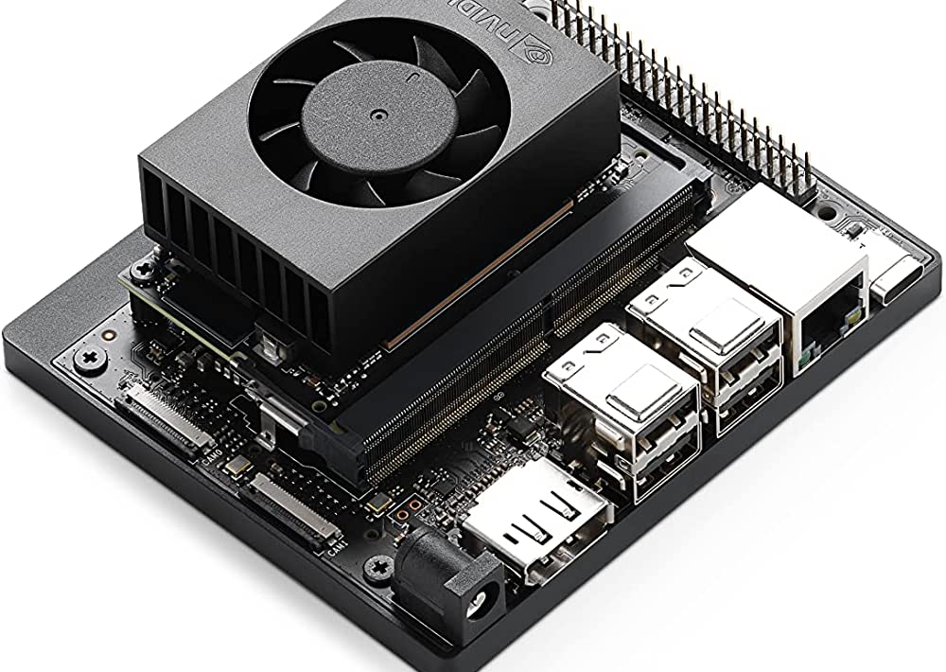
Hardware
Nvidia Jetson Board
The NVIDIA Jetson is a small, low-power embedded computing device designed for AI and machine learning applications. It's powered by an ARM processor and NVIDIA's Maxwell GPU architecture, which provides high-performance computing for edge devices and embedded systems

Slide 10
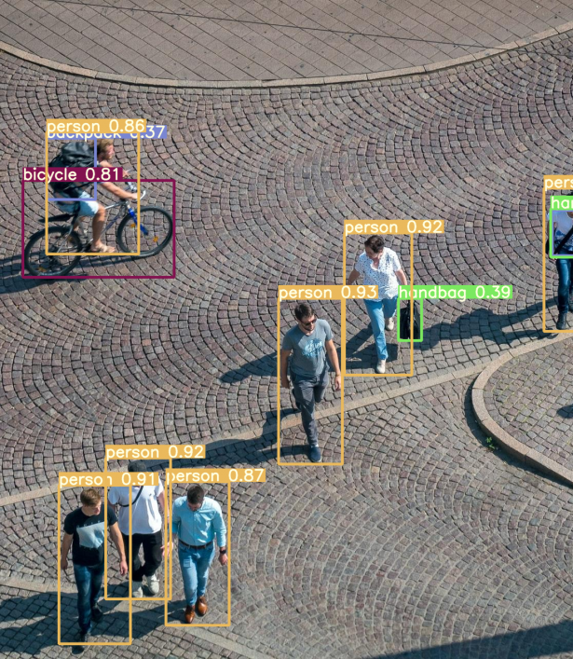
Software
Object Detection Algorithms
Object detection algorithms are used in computer vision to identify and locate objects within images or videos. These algorithms utilize deep learning techniques, such as convolutional neural networks (CNNs), to analyze visual data and make predictions about the presence, location, and class of objects.

Slide 11
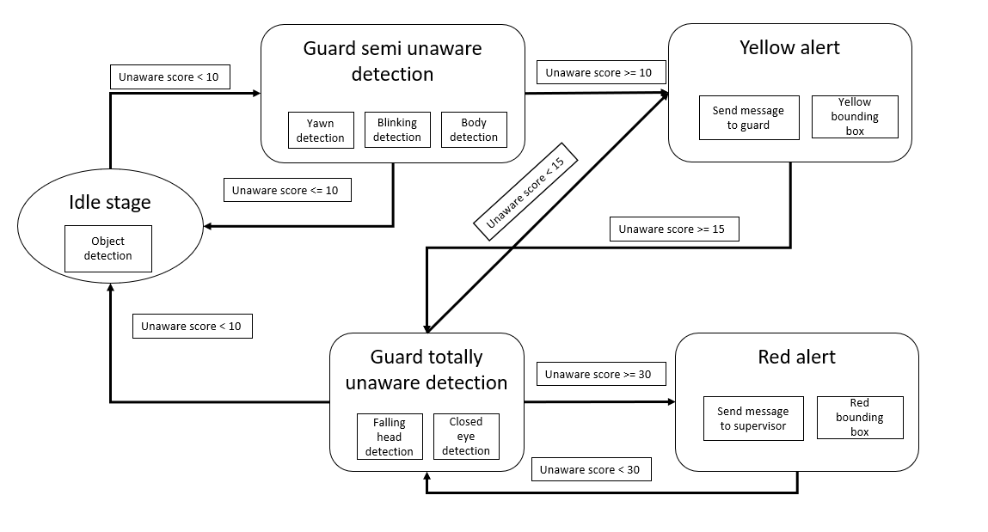
How Will The System Work?
The system have 3 main parts

Slide 12
Object Detection
Object 0.92

Slide 13
Score
Object 0.92

Slide 14
Alert
Object 0.92

Slide 15
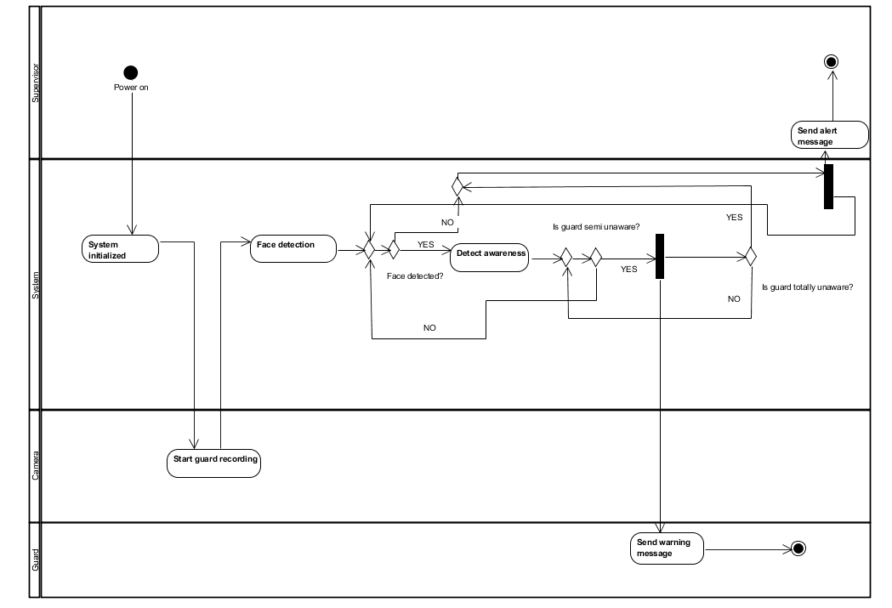
Activity Diagram

Slide 16
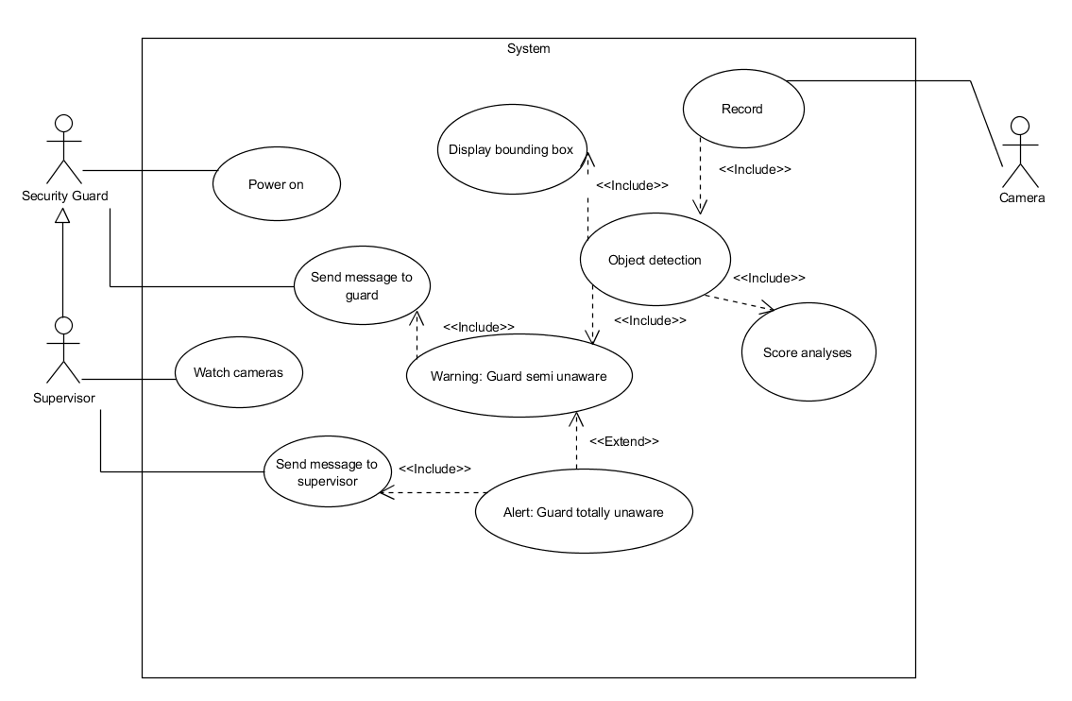
Usecase Diagram

Slide 17
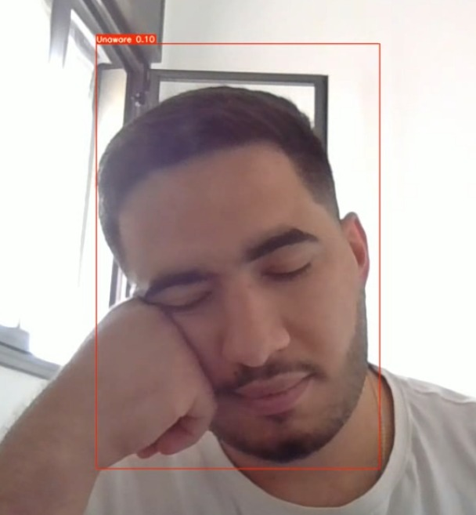


Example
Red Alert
Alert
Detect

Slide 18
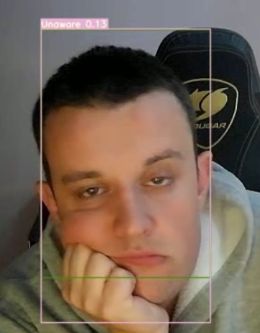
Now The Handsome One

Slide 19

CNN
Convolutional Neural Networks (CNNs) are deep learning algorithms for image processing. They learn features through convolutional layers that apply filters to the input image. Pooling layers down sample the features, and fully connected layers generate predictions. CNNs excel at visual tasks by capturing relevant features and hierarchical patterns. They are widely used in image classification, object detection, and more.

Slide 20
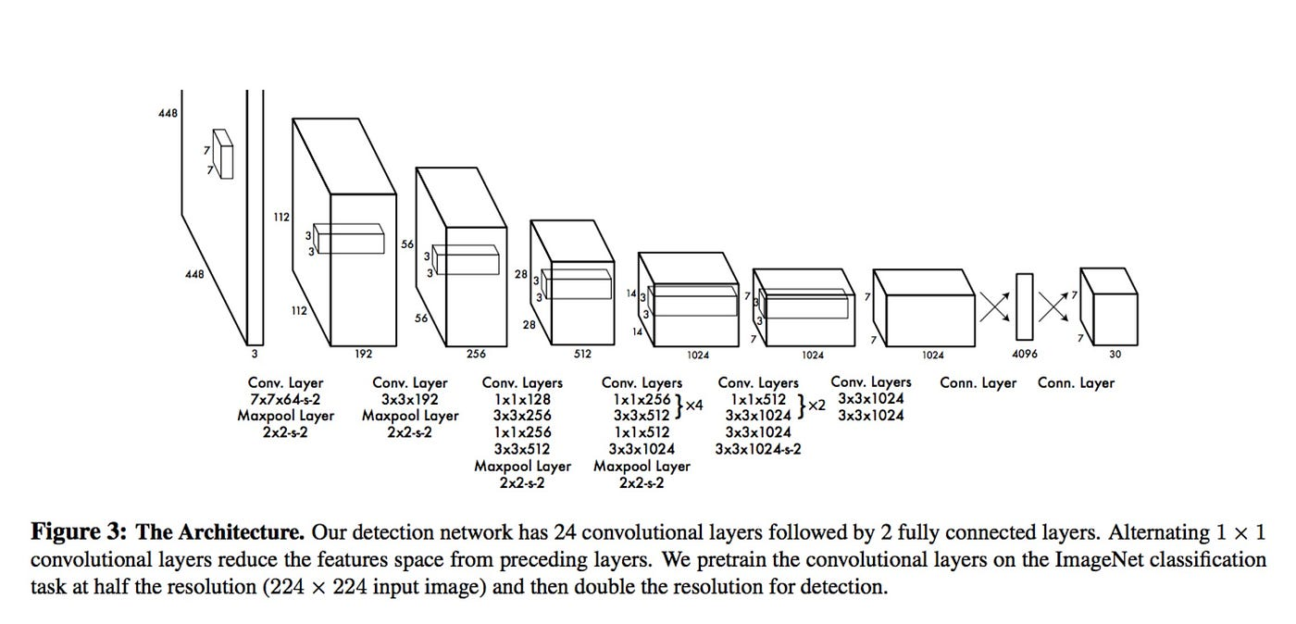
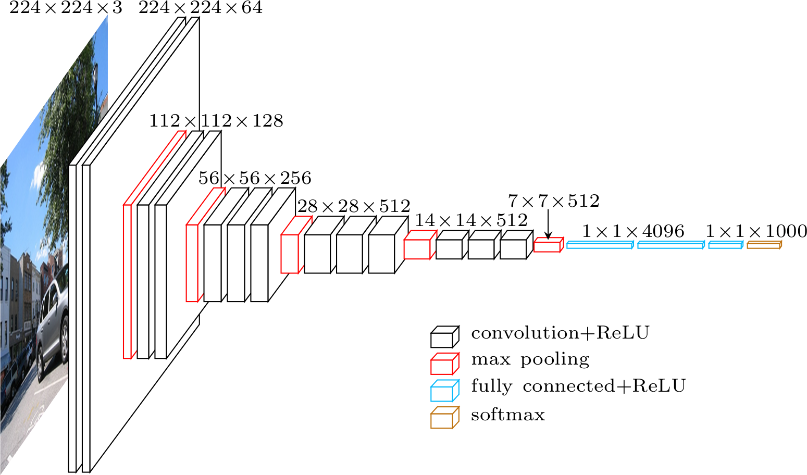
Architecture
YOLO and Faster R-CNN are object detection algorithms used in computer vision. YOLO is known for its real-time performance, dividing the image into a grid and making predictions directly. However, it may struggle with small objects. Faster R-CNN employs a two-stage approach using region proposals, resulting in precise localization but slower speed. Both algorithms have contributed to advancements in object detection for various applications.
Faster-RCNN
YOLO

Slide 21

Challenges
Data
Overfitting
False positives

Slide 22

Q&A

Slide 23

Thank You!

